Slide 1
Coupa Training For CHS Suppliers

Slide 2
CSP vs. SAN
Coupa Invoice Submission Method | Description | E-Invoice? | Manual Processing Required (H, M, L) | Comments on Invoice Processing
CSP | Coupa Supplier Portal* | P | L (Low) | The Coupa Supplier Portal (CSP) is a portal that captures PO and Invoice information for suppliers. The suppliers can log into the portal to track transactional activity and to initiate invoices, which will feed electronically to CHS.
SAN | PO converts to invoice via Email (Supplier Actionable Notification) | P | L (Low) | Suppliers with valid email address can “flip” a PO e-mail directly into an electronic invoice in Coupa Only invoice exceptions are processed by AP. Suppliers DO NOT have access to the portal.

Slide 3
Introduction to the Coupa Supplier Portal (CSP)
The Coupa Supplier Portal (CSP) is a free platform that suppliers can use to transact directly with CHS through Coupa. The CSP allows a supplier to:
  Manage company information with CHS
  Electronically view Purchase Orders and invoice against those orders directly
  View the status of invoices in real-time

Slide 4
Introduction to Supplier Actionable Notifications (SAN)
Alternatively, a supplier can use Coupa’s Supplier Actionable Notification (SAN) functionality. A supplier only needs to provide an updated email address to receive POs
  The email address should be regularly checked to ensure timely purchase to pay

Slide 5
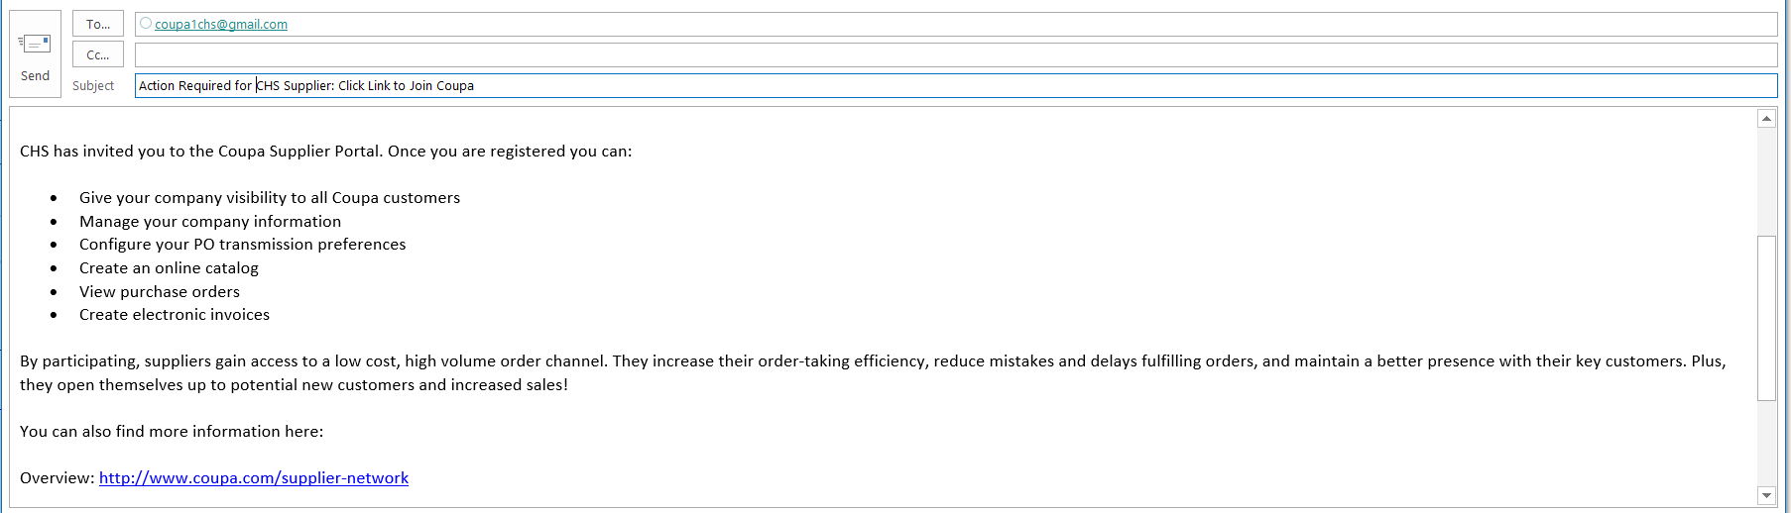
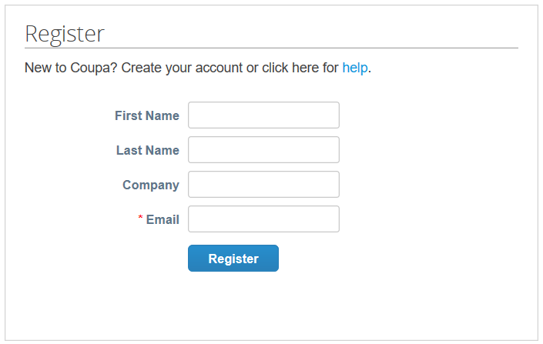
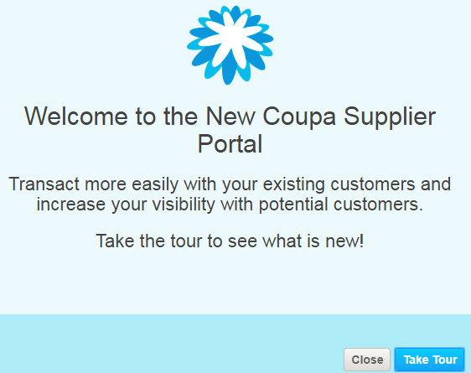
Joining the Coupa Supplier Portal (CSP)
To link with CHS on the CSP, the supplier contact will receive the following email:
Suppliers will be prompted to create an account and take a guided tour of the portal
Suppliers not opting for this method of PO/Invoice Transmission need to provide a valid business email in order to receive POs and Transmit Invoices back to Coupa
5
Notes:
Jump into Coupa to show Supplier Portal

Slide 6
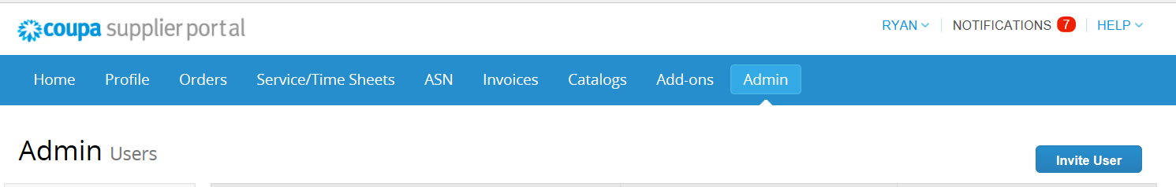
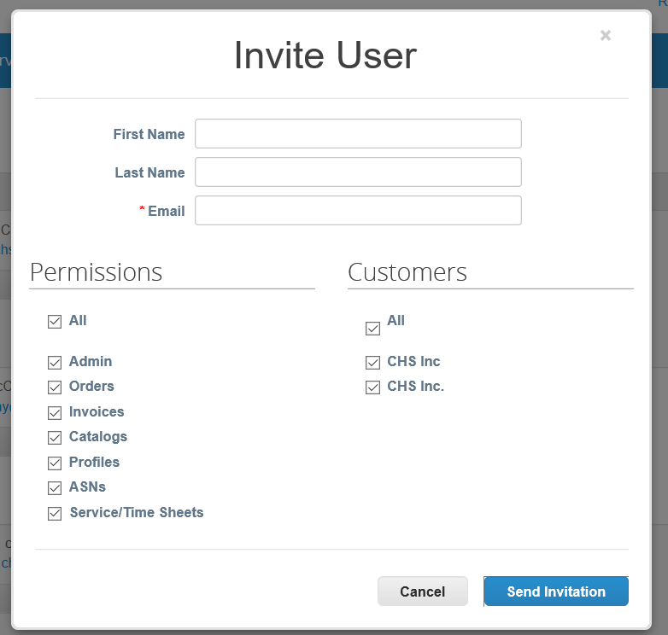
To add users, first select “Admin” then click “Invite User”
Adding Additional CSP Users
1
2

Slide 7
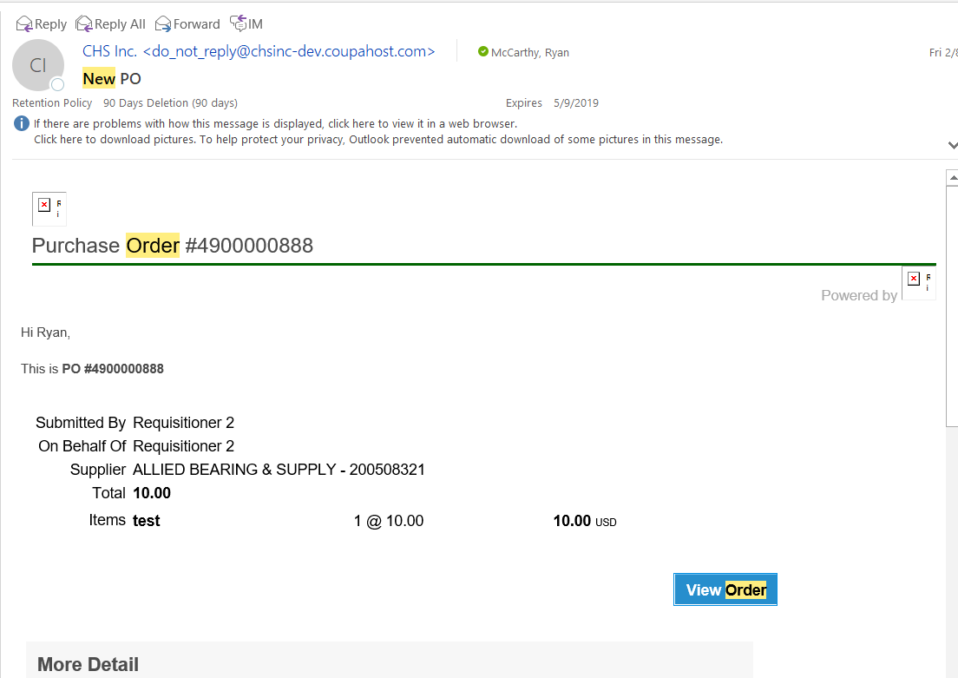
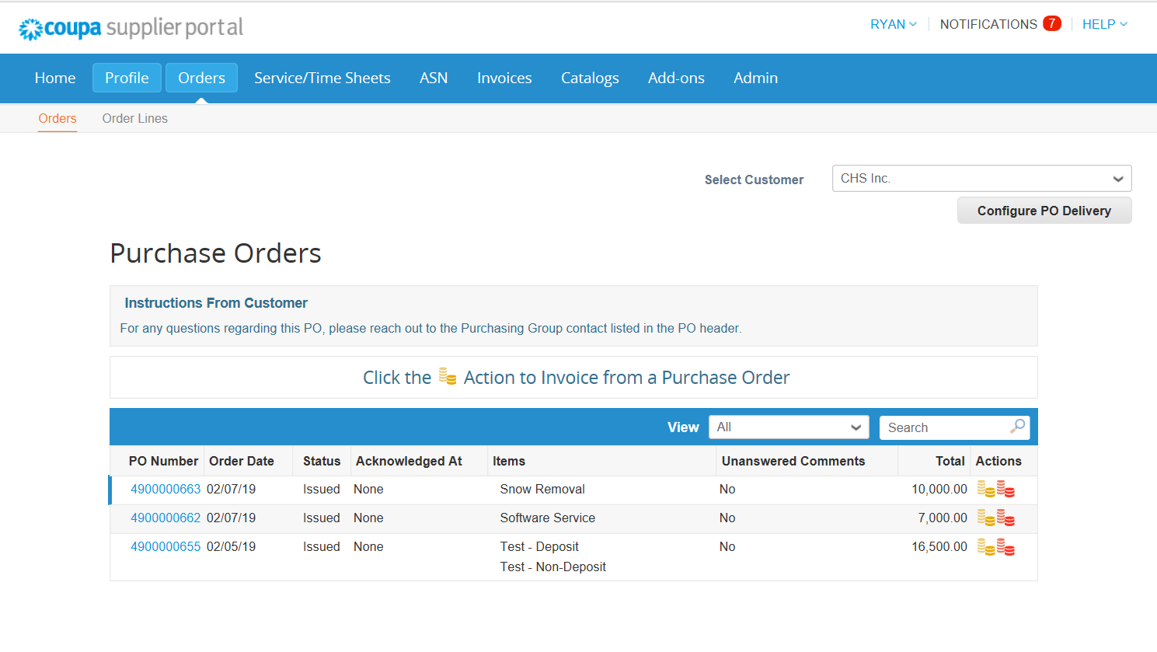
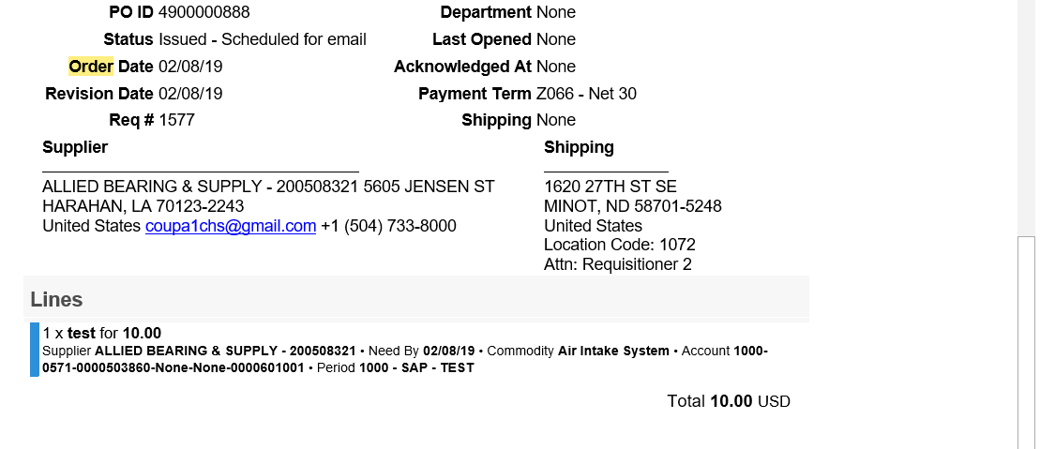
Receiving and Viewing POs (CSP)
PO Email
PO in CSP

Slide 8
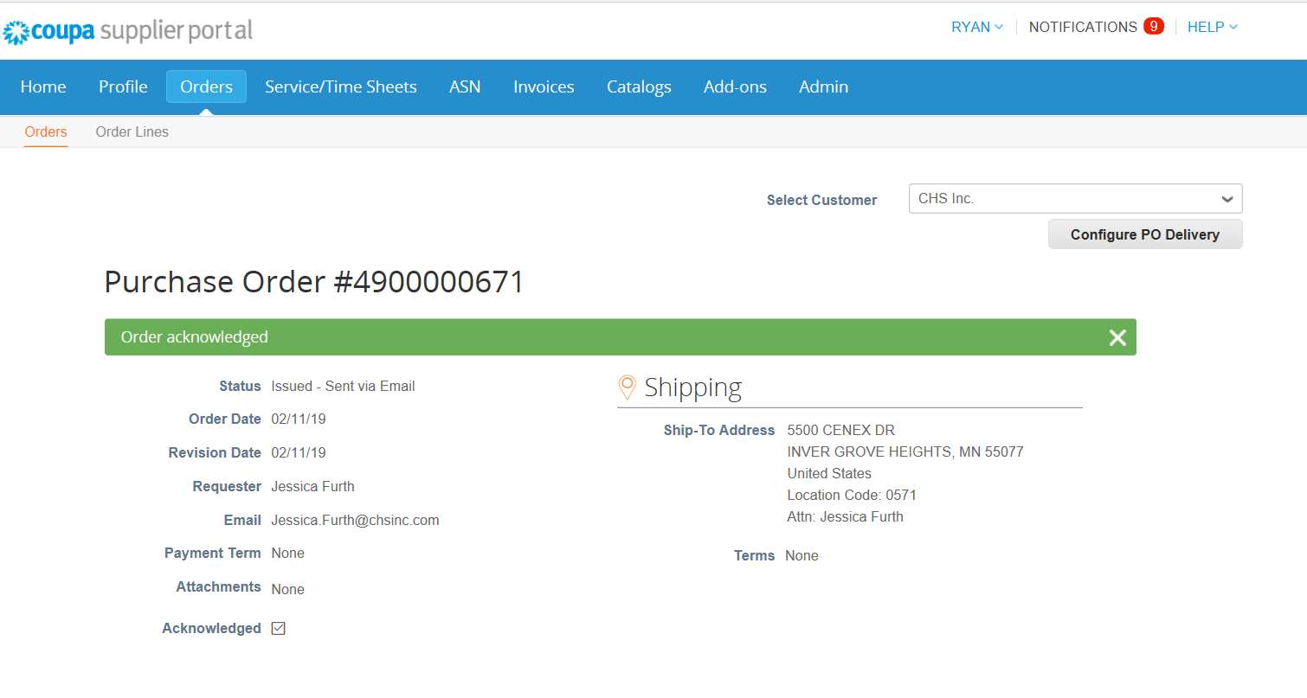
Acknowledge PO (CSP)
Check the Acknowledged box to inform CHS the order has been received

Slide 9
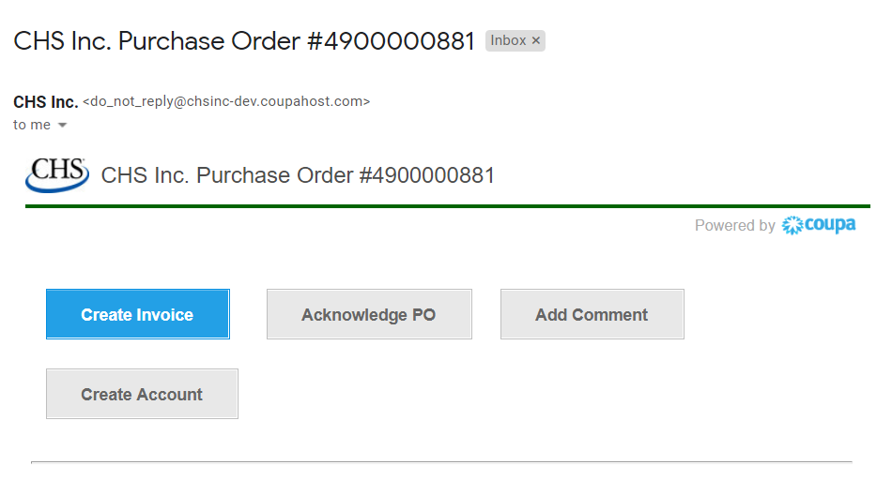
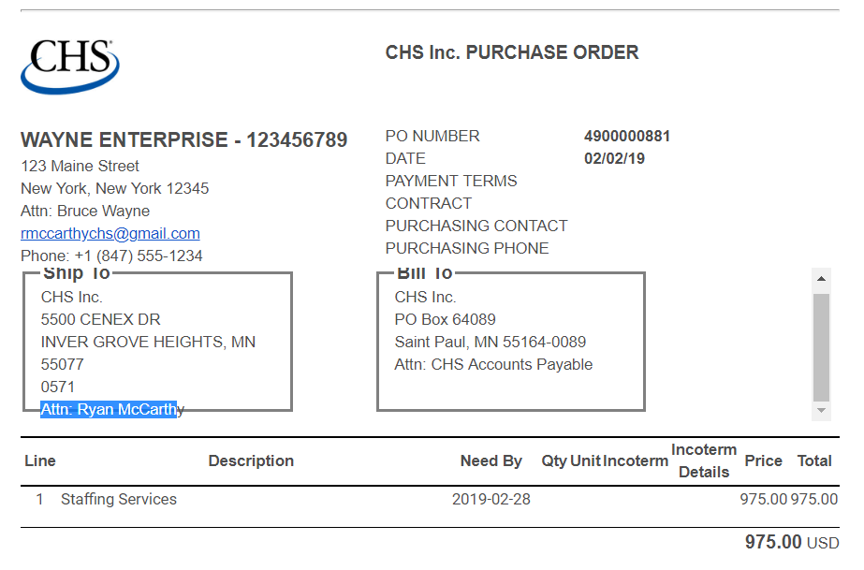
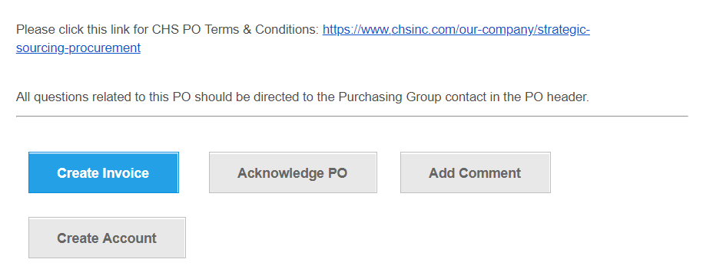
Receiving and Viewing POs (SAN)
Top
Middle
Bottom

Slide 10
Acknowledge PO (SAN)
The acknowledge PO button in the SAN email will update CHS the PO has been received

Slide 11
Invoicing (CSP)
To create an invoice, click the gold coin icon
Notes:
Jump into Coupa to show Supplier Portal

Slide 12
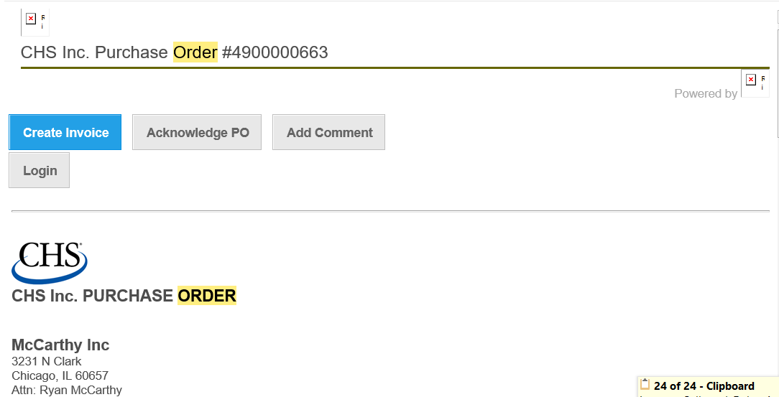
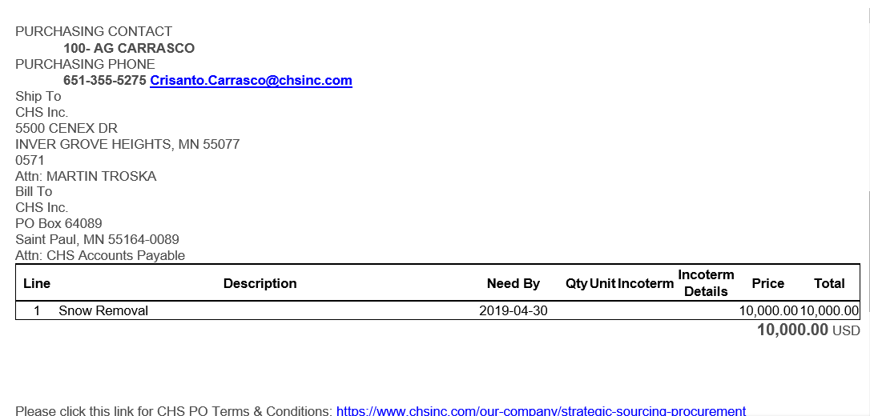
Invoicing (SAN)
To create an invoice, click the blue button
Notes:
Jump into Coupa to show Supplier Portal

Slide 13
Questions?
Do you feel comfortable transacting with CHS on Coupa?
Contact CHS’ Coupa support team: CHSStrategicSourcing@chsinc.com
Support is also available directly from Coupa: https://success.coupa.com/Suppliers/For_Suppliers

